Slide 1
Henry Ford Early College
Health Careers
Advanced Manufacturing
& Technology
Pre-Education

Slide 2
Background
Located on the Henry Ford College campus
5 year high school program
Associate’s Degree
Certification in one of many programs available
Transferable credits 60+
College scholarships to 4-year universities
Partnerships: Ford NGL, HF Health System & DPS
Transportation/Extra-Curricular Activities

Slide 3
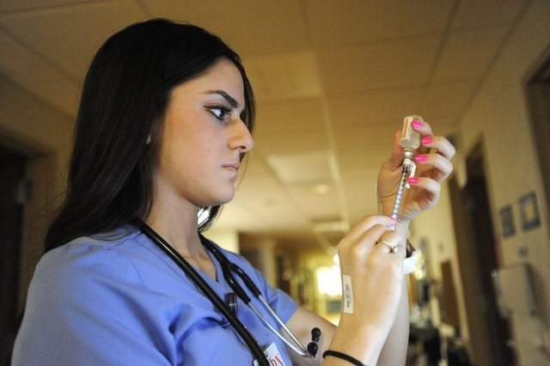
Application
Application will be available soon
Deadline is March 1st
Must complete an application packet - It will be sent to your DPS email address
Packet includes:
Student application
Current report card
Solid grades in core classes
Student writing sample
Recommendation letters
Applications may only be submitted for ONE early college program.
Student Spring Testing
Reading Comprehension Test
Students are selected from a lottery
Students in Wayne County are eligible for all 3 programs.

Slide 4
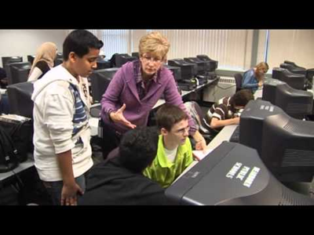
On The Right Course…
9th Grade – HEALTH
9th Grade – MFG & EDU
Language Arts
Math
World History
Biology
Physics
PE/Health
Language Arts
Math
World History
Biology
PE/Health
Math / LA Plus

Slide 5
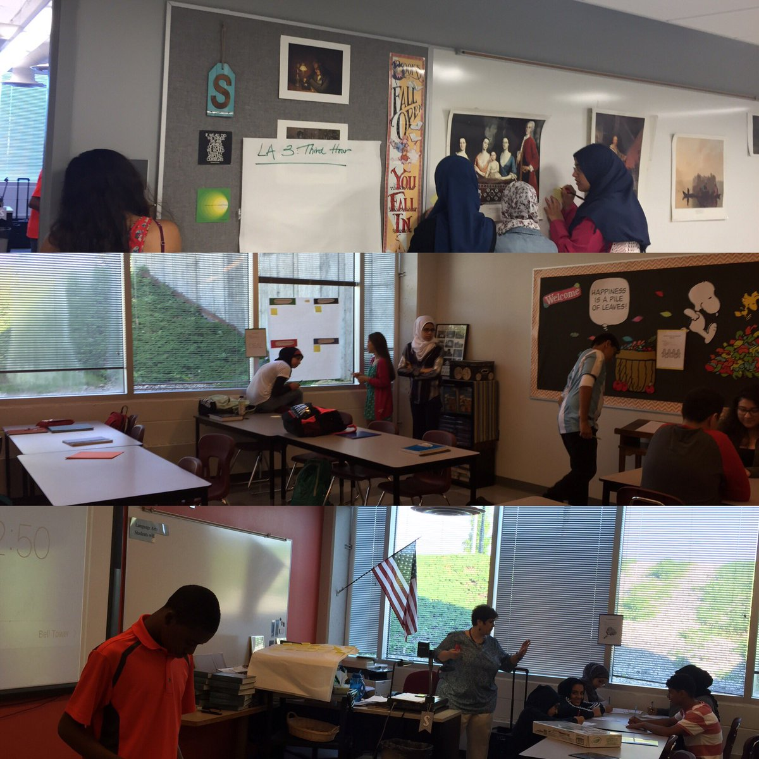
On The Right Course…
10th Grade – HEALTH
10th Grade – MFG & EDU
Language Arts
Math
Chemistry
Anatomy & Physiology
US History
College Courses
Language Arts
Math
Chemistry
US History
College Courses

Slide 6
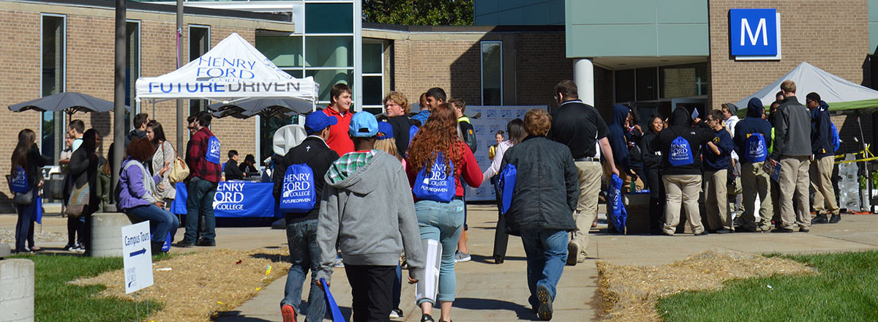
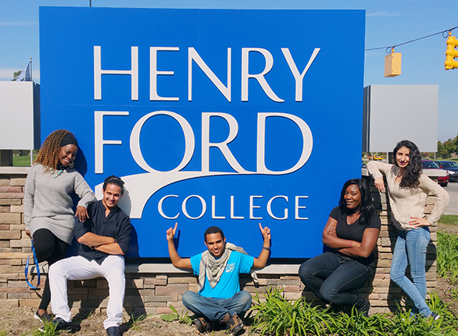
On The Right Course…
11th Grade
12th Grade & 13th Year
High School Ends: 10 AM or 11 AM
Part-Time College
Full-time College Schedule

Slide 7
Health Career Programs
Medical Assistant
Medical Insurance Specialist
Nursing - RN
Ophthalmic Technician
Paramedic
Pharmacy Technician
Pre-Professional
Physical Therapy Asst.
Radiographer
Respiratory Therapist
Surgical Technologist

Slide 8
Manufacturing Career Programs
Computer Information Systems
CAD – CAM Technician
HVAC – Energy Technology
Architecture/Construction Technology
Pre-Engineering
Engineering Technology
CNC – Machine Tool
Automotive
Electronics
Welding

Slide 9
Pre-Education Career Programs
Special Education
Child Development
Elementary Education
Secondary Education
Paraprofessional Certificate

Slide 10
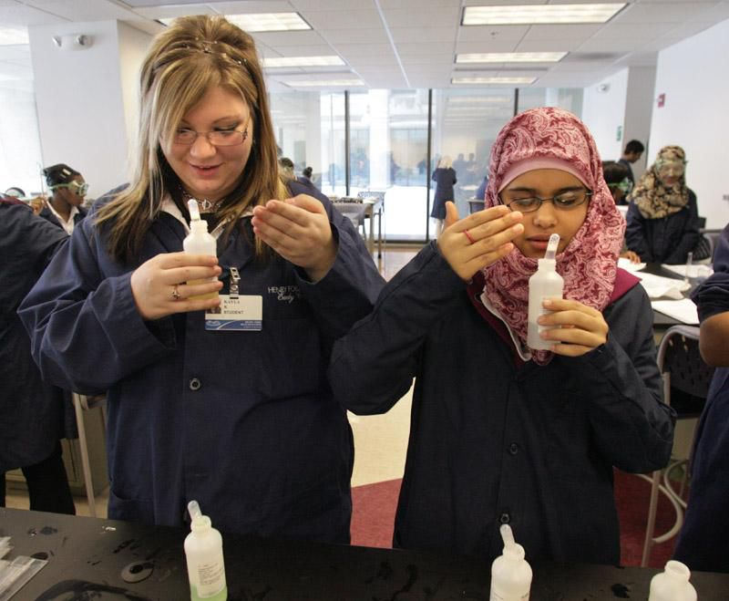
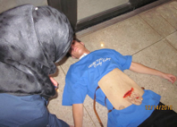
Field Experiences - HFHS Clinical Rotations - Health

Slide 11
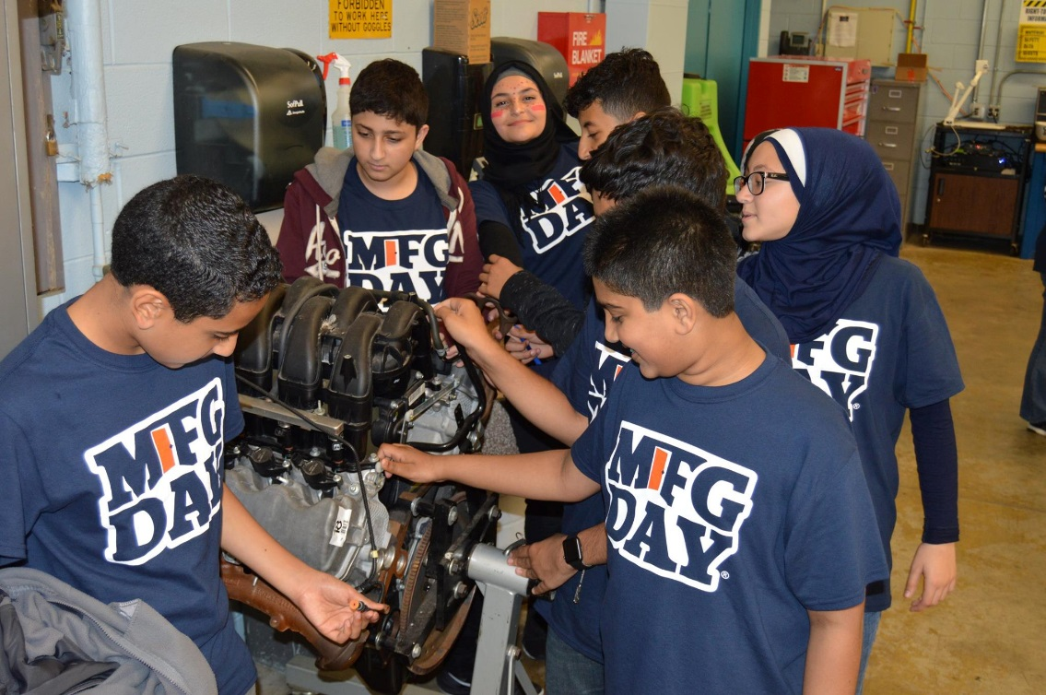
Field Experiences - Ford NGL Partnership - MFG
9th grade - Technology Rotations & Manufacturing Day
10th grade - Mentoring Program
11th grade - High School Science & Technology Program
12th grade - Potential Internships

Slide 12
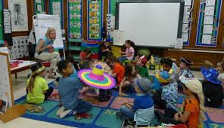
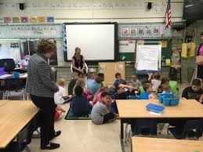
Field Experiences - Dearborn Schools - Pre-Education
Classroom visits twice a month
Observations - Interacting with students - Small group instruction - Professional skill-building

Slide 13
Collegiate Academy
Similar to the Early College Programs - Adds a 5th year to high school
Opportunity to earn 60+ college credits/associates degree
Open to students from DHS, EFHS and FHS
Begins in 11th grade - students remain part of their home high school
Eligibility based on PSAT scores in 10th grade

Slide 14
Contact Information...
Henry Ford Early College
5101 Evergreen, Dearborn, MI 48128
313.317.1588
Majed Fadlallah, Principal: fadlalm@dearbornschools.org
Marwan Salamey, Assistant Principal: salamem@dearbornschools.org
Karry Bazzi, Counselor: bazzik1@dearbornschools.org
Michael Gothro, Counselor: gothrom@dearbornschools.org

